Slide 1
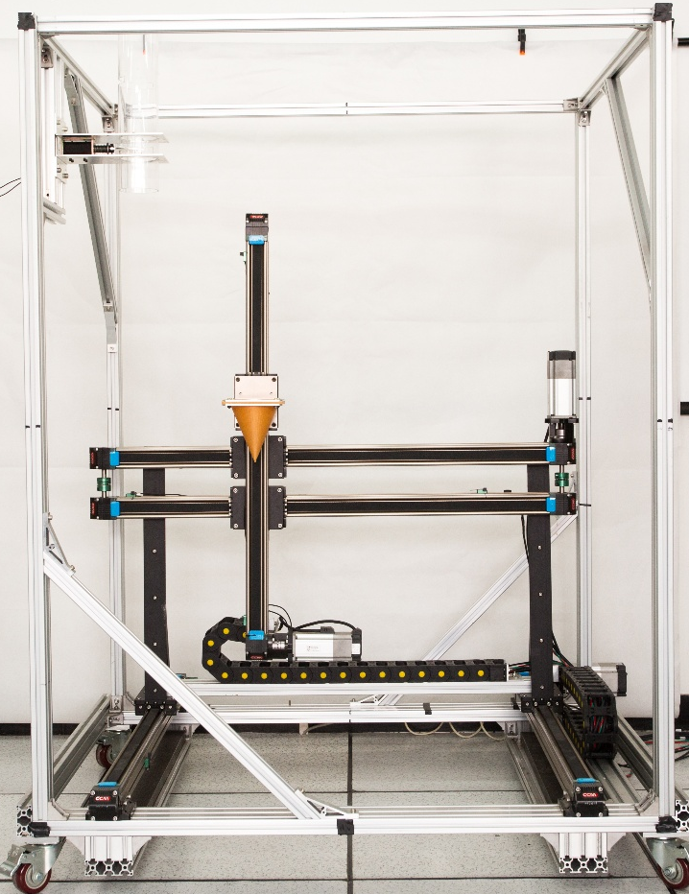
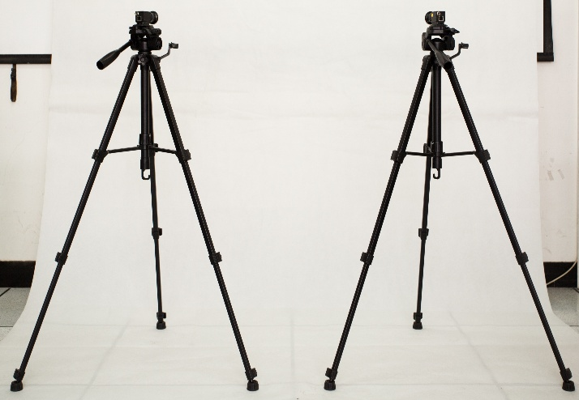
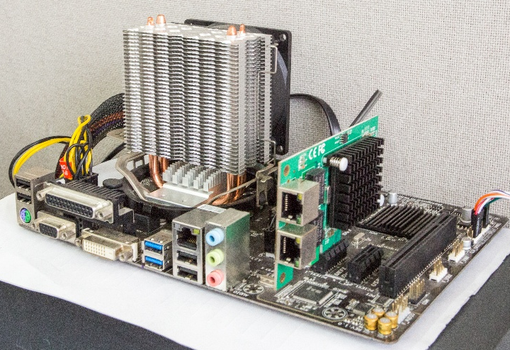
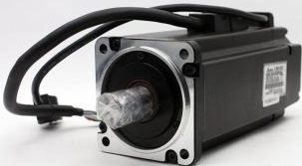
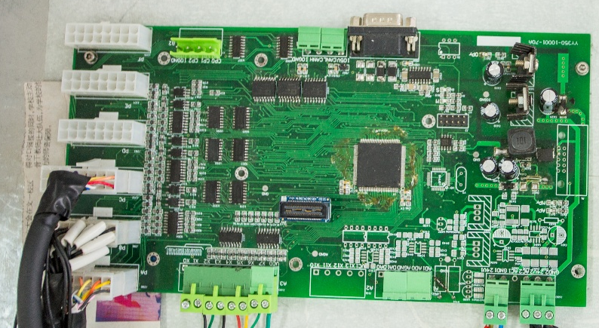
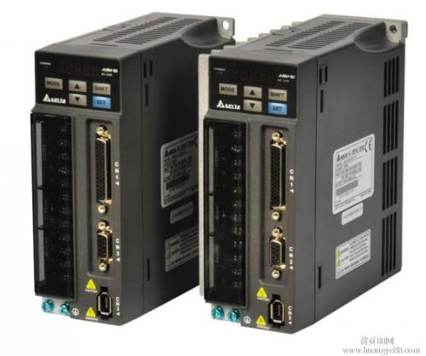
Vision system
Can bus
Pluse
Actuator
Control system

Slide 2
G00
Part A
G01
Can Bus
G02
Part B
…
M01

Slide 3









FP
cv
01
cv
cv
cv
DFPstart+$i$
DFPstart+$j$
DFPstart+$k$
$$f$$
$$h$$
CP
cv
cv
cv
cv
MFPstart+$1$
DCPstart+$i^{′}$
DCPstart+$j^{′}$
DCPstart+$k^{′}$

Slide 4


1
0
0
0
1
cv
cv
cv
cv
cv
0
0
0
0
01
cv
cv
cv
cv
cv
cv
cv
DFPstart+$i$
DFPstart+$j$
DFPstart+$k$
M
…
DFPstart
DFP
2
…
DCPstart
DCP
…
…

Slide 5
PP
CP1
MFPstart+i
MFPstart
MFPstart+i
CP2
MFPstart+1
…
…
MFPstart+j
MFPstart+i+1
CPi
…
MFPstart+i-1
CPi+1
MFPstart+i
Flexible program
Control program

Slide 6
Fast Thread
Middle Thread
Slow Thread
…
…
…
Mid
Flag
Slow
Flag
…
…
Slow
Flag

Slide 7
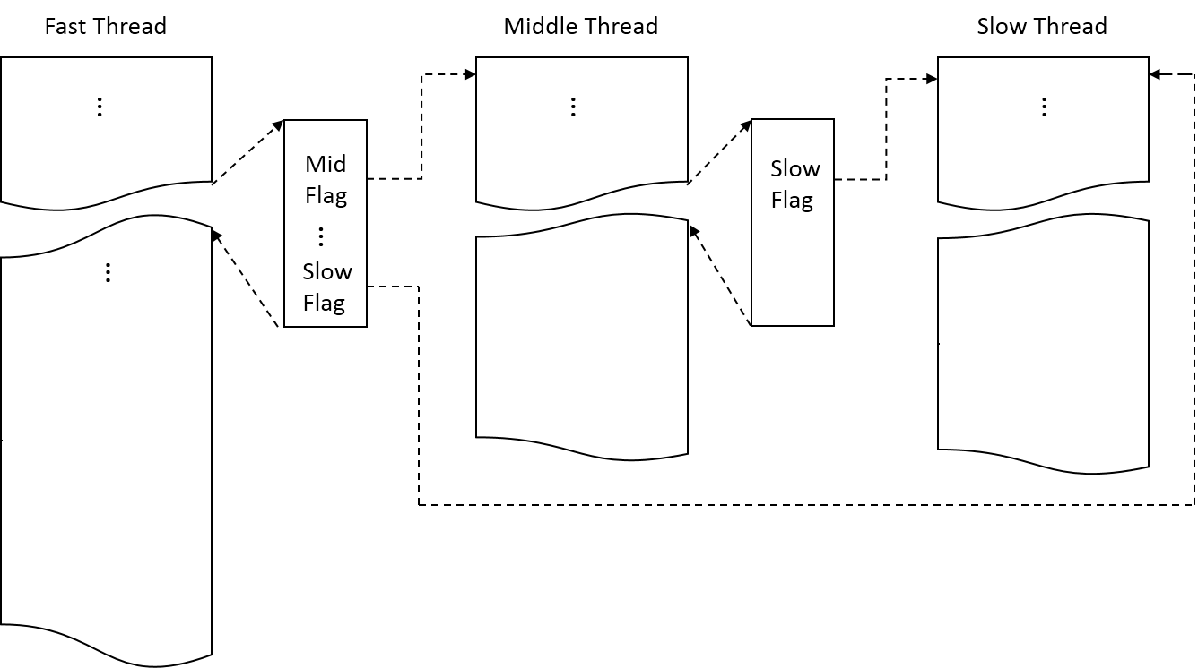

Slide 8
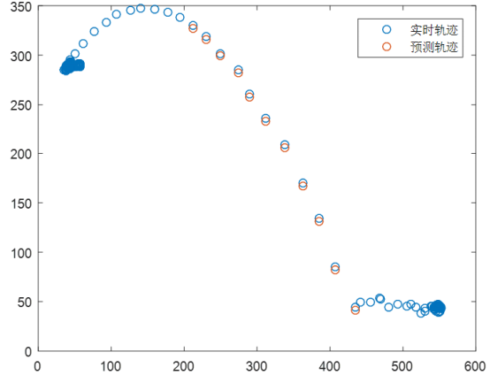
cv
cv
cv
cv
RT trajectory
03
420.9
47.2
10.5
100
890
920
PD trajectory
cv
cv
cv
cv
03
420.0
48.6
10.3
100
890
920
cv
cv
cv
cv
…
…
…
…
…
…
…
Vision
system
cv
cv
cv
cv
03
423.1
46.5
9.8
100
890
920
cv
cv
cv
cv
03
420900
47200
10500
100
890
920
cv
cv
cv
cv
ePLC
03
420000
48600
10300
100
890
920
cv
cv
cv
cv
…
…
…
…
…
…
…
cv
cv
cv
cv
03
423100
46500
9800
100
890
920

